Slide 1
DEC WASTEWATER DISPOSAL
By Harrison Hee

Slide 2
WASTEWATER
Many different qualities in wastewater that must be tested before being discharged
Alkalinity, metals (antimony, arsenic, lead, mercury, copper, etc.), VOC’s, BOD, nutrients (nitrogen and phosphorus), suspended solids, pH, temperature, and even more!
Notes:
Wastewater treatment is crucial because everything we put into our wastewater cannot 100% be removed even in treatment and we must be vigilant and maintain high standards so our surface water remains clean enough for consumption and daily use.

Slide 3
DEC - DEPARTMENT OF ENVIRONMENTAL CONSERVATION
Mission is to conserve, improve, and protect Alaska’s natural resources and environment to enhance the health, safety, economic, and social well-being of Alaskans
Division of Water – Randy Bates (907-269-7673)
APDES – Alaska Pollutant Discharge Elimination System
Clean Water Act
Limited EPA overview in Alaska
Notes:
The Clean Water Act prohibits discharge of pollutants from a point source in water into a water of the U.S. unless the discharging facility has a wastewater discharge permit. Section 402 created the National Pollutant Discharge Elimination System. EPA retains permitting and enforcement authority in some facilities in Alaska, including federal facilities in Denali National Park, Indian country.

Slide 4
APPLICABILITY
An APDES permit is required when there is a discharge of pollutants to surface water
Examples of facilities included are wastewater treatment plants, log storage and transfer facilities, seafood processors, fish hatcheries, mines, and oil and gas facilities
Pollutant: Any kind of industrial, municipal, or agricultural waste discharged into water
Standards set by EPA for each individual state
https://www.epa.gov/wqc/national-recommended-water-quality-criteria-human-health-criteria-table
Notes:
Pollutants include sludge, heavily metals, oil, and dirt. Standards for EPA include both drinking standards and effluent standards.

Slide 5
TWO TYPES OF PERMITS
Domestic/Municipal
Industrial
Notes:
Each has a general or individual permit.

Slide 6
GENERAL VS INDIVIDUAL
General permit – Discharges from more than one facility with similar wastewater characteristics in a defined geographical area
Individual permit – Discharges from a single facility and has specific terms, limits, and conditions tailored to that facility
Notes:
General permits are issued to facilities that meet established conditions and limits within a given territory.

Slide 7
DOMESTIC/MUNICIPAL
Covers water-borne human wastes or graywater from dwellings, commercial buildings, or institutions
Individual permit name is APDES Form 2A
General permit names are AKG572000 (small publicly owned treatment works) and AKG573000 (lagoons discharging into surface water)
Earl Crapps (907-269-7681)
Marie Klingman (907-451-2101)
Notes:
Earl Crapps is the program manager of the Domestic/Municipal Wastewater Permitting program and of the Industrial/Non-domestic wastewater section. Marie Klingman is the staff contact in Fairbanks.

Slide 8
INDUSTRIAL
If discharge is not to surface waters, then a state permit is needed
Typically general unless for a specific facility or a specific disposal activity
Individual broad permit is APDES Form 1: General, needed for anyone applying for an individual permit
Earl Crapps (907-269-7681)
Marie Klingman (907-451-2101)
Notes:
Earl Crapps is the program manager of the Industrial/Non-domestic wastewater section.

Slide 9
INFO NEEDED
Geographic location of facility
General party information
Pollutant characteristics
Potential environmental effects of pollutants into surface water
Rate of discharge
Nearby bodies of water
Existing environmental permits
Testing data for BOD, TSS, pH, flow rate, fecal coliform bacteria, residual chlorine

Slide 10
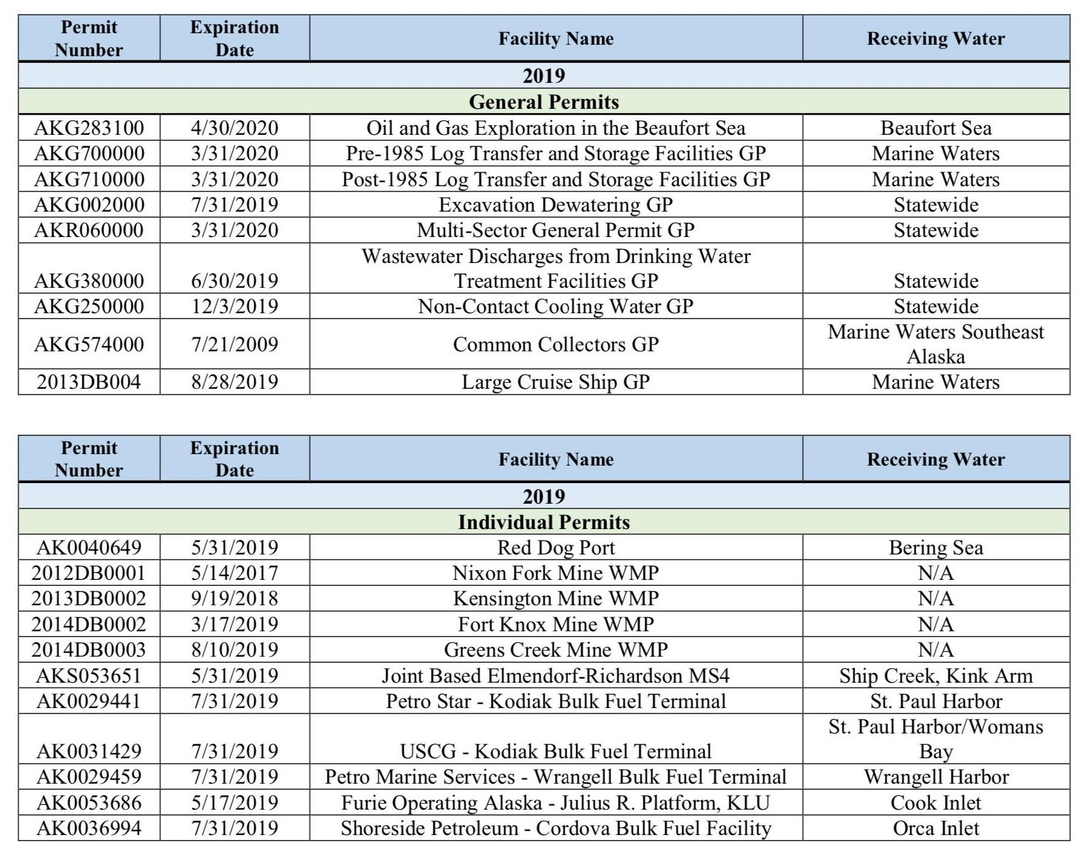
PIP – PERMIT ISSUANCE PLAN
PDF available on the DEC website that lists upcoming and expiring permits
Updated annually and sent out electronically via mailing list

Slide 11
TIMELINE
Pre-application (30 – 90 days)
Data collection (not necessary, but will take about 1 year if needed)
Application preparation (30 – 90 days)
Review of data submittal (60 – 120 days)
Completeness review (30 days)
Supplemental application (10 – 90 days)
Review application and draft permit (60 – 180 days)
Collect public comment (30 – 90 days)
Prepare final permit (10 – 30 days)
Issue final permit
Cumulative time from initial application: 180 – 570 days
Notes:
Blue is applicant’s action. Red is DEC’s action.

Slide 12
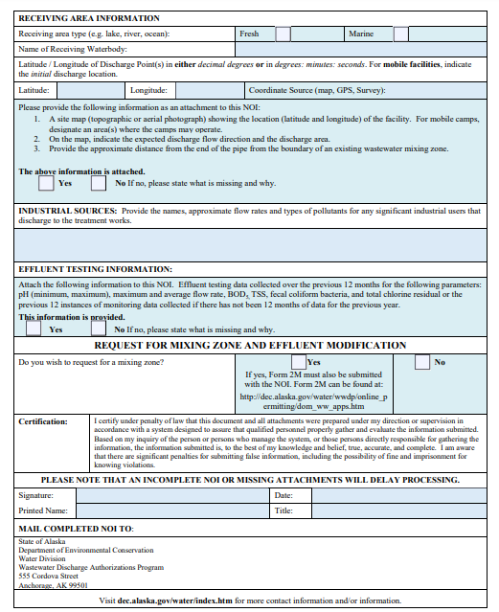
FORM AKG572000

Slide 13
GENERAL INDUSTRIAL PERMIT EXAMPLE
Permit number AKG380000 – Wastewater Discharges from Drinking Water Treatment Faciliti
Issued July 01, 2019
Expires July 31, 2024

Slide 14
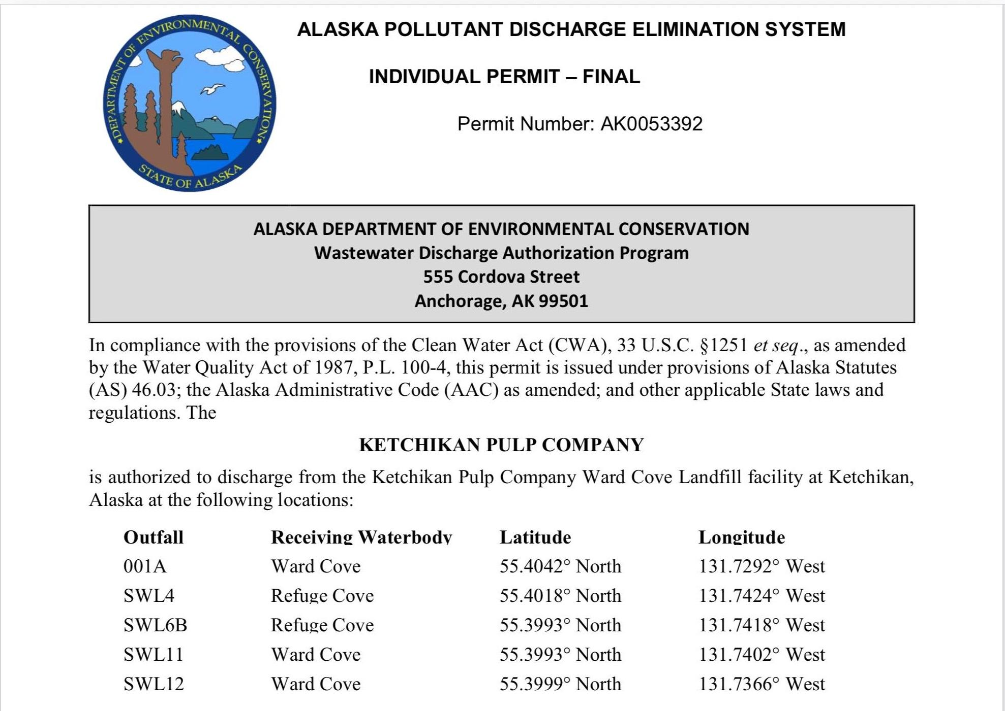
INDIVIDUAL INDUSTRIAL PERMIT EXAMPLE
Permit Number AK0053392 – Ketchup Pulp Company
Authorizing discharge from Ketchikan landfill
40 page document
Notes:
Permit includes discharge authorization, effluent limits and monitoring requirements, additional effluent and storm water monitoring requirements, approval for a mixing zone for manganese, color and whole effluent toxicity, quality assurance project plan, best management practices plan, and removed substances. Effective March 1, 2020 and expires February 28, 2025. Important: must reapply on or before September 1, 20204, 180 days before experiation.

Slide 15
GENERAL DOMESTIC PERMIT EXAMPLE
AKG573000 – Small Domestic Lagoon to Surface Water GP
Issued July 12, 2018
Expires August 31, 2023

Slide 16
INDIVIDUAL INDUSTRIAL PERMIT EXAMPLE - LAGOONS
Major (practically only) way for rural communities in Alaska to discharge
Communities fill up a lagoon with honey bucket wastewater and discharge it periodically after filling it up
As populations grow, pollutants become a major issue with these lagoons
Funding to build proper sewage systems has decreased over the years and is continuing to decrease
Huge concerns with transportation and leakage of waste from honey buckets
Program Village Safe Water (VSW)
Young Ha (907-269-7544) young.ha@alaska.gov
Notes:
Honey buckets are plastic-lined buckets collecting human waste. 3,300 homes in 30 communities lack proper systems. Program VSW is headed by project manager Young Ha

Slide 17
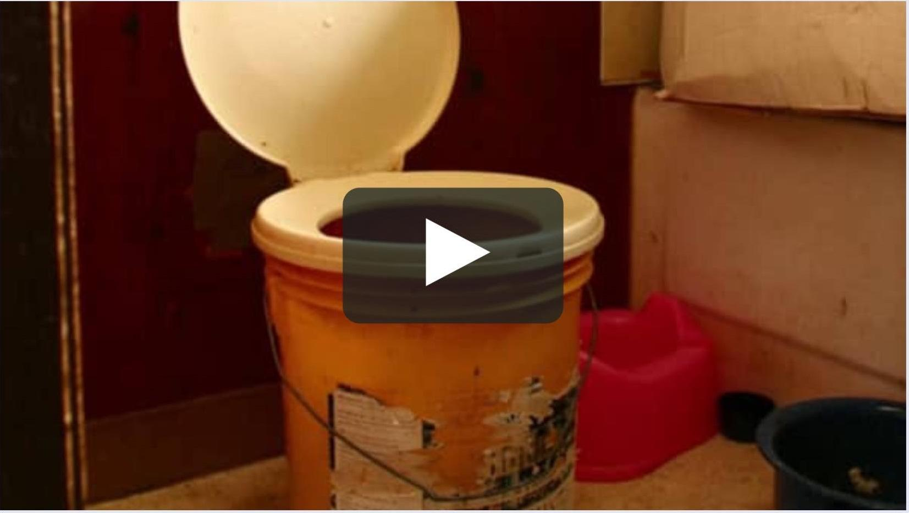
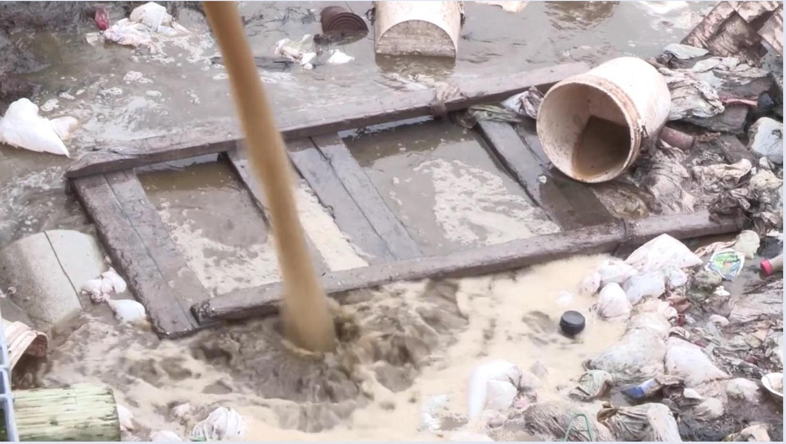
LAGOON DUMPING

Slide 18
RESOURCES
https://dec.alaska.gov/water/apdes-history/faq?fbclid=IwAR2s8nEl8O9wbDplOP_hrGIxU9VDCqXQWVXppA-Xf3HvdUTETUozP7VXtg4
https://dec.alaska.gov/water/village-safe-water/?fbclid=IwAR1ZqK4aaMSw0qeRnPAoOForNFJdXQVw-S19DRkO3SKgj8PEH8EVyPnIrP0
https://dec.alaska.gov/water/wastewater/
http://www.legis.state.ak.us/basis/get_documents.asp?session=27&docid=4223&fbclid=IwAR3fL4DJwFe8-nQDJ_KhK9Brm_gs_Tnic28AHj2i5QfnNYMeveqzyp7KrG4
https://www.epa.gov/sites/production/files/2014-12/documents/akwqs-chapter70.pdf?fbclid=IwAR18mHNrczafZDQZW4O6IergKUcc75zq-VjrP5L9C_aG1sXhxFKJeLntbx0
https://www.epa.gov/eg/effluent-guidelines-implementation-compliance

